Slide 1

Mission-Centric Countermeasure Selection in
Cybersecurity Situation Awareness Systems
Sajed Yousefi Mashhour¹, Motahareh Dehghan² Babak Sadeghiyan¹, Alireza Hashemi Golpayegani¹
¹ Amirkabir University of Technology
² Tarbiat Modares University

Slide 2






Outline
1
Introduction
2
Related Work
3
Proposed Framework
4
Implementation & Case Study
5
Results and Discussion
6
Conclusion

Slide 3
Motivation & Problem Statement
The Cybersecurity Challenge:
Modern organizations rely on complex digital infrastructures Sophisticated cyber threats pose risks to core missions
Gap: Traditional security focuses on technical risk, not organizational objectives
Suboptimal Countermeasure Selection
Current cybersecurity systems do not systematically support countermeasure selection that aligns with both risk reduction and mission objectives.
Consequences: Inefficient resources, operational disruption, erosion of mission capabilities

Slide 4
Research Gaps
Early Models: Static, risk/cost-focused, isolated from business context
IDS-Centric: Automated responses to detected threats [4]
Limitations: Evasion, false positives, scalability
Attack Graph-Based: Formalize attack paths [2,3]
Limitations: Complexity, perfect intelligence dependency
Persistent Research Gaps
Mission Disconnect • Scalability Issues • Reactive Bias

Slide 5
Our Approach
Key Innovations:
Extends RiskMAP [1] through Agent-Based Modeling (ABM) and Discrete-Event Simulation (DES)
Dual-directional propagation:
Top-down: Relative Weight from Mission → Threat
Bottom-up: Technical risk from Threat → Mission
Uses MITRE ATT&CK to identify threats and MITRE D3FEND to find available countermeasures
Employs multi-criteria decision-making

Slide 6
Our Approach
Relative Weight
Calculation
Technical Risk
Calculation
Mission
Task
Task
Asset
Asset
Threat
Threat
Countermeasure
Countermeasure

Slide 7




Workflow
InformationAcquisition
Process Steps:
Information Acquisition Risk Assessment Countermeasure Selection Simulation & Evaluation
RiskAssessment
1
2
Countermeasure selection
3
4
Simulation & Evaluation
Key Components: Mission objectives, tasks, assets, vulnerabilities, threats (ATT&CK), countermeasures (D3FEND)

Slide 8
Workflow: Information
Document mission objectives and assign Confidentiality, Integrity, and Availability (CIA) weights.
Map organizational tasks, critical assets, vulnerabilities, and threat intelligence using MITRE ATT&CK.
Identify candidate countermeasures via MITRE D3FEND.

Slide 9
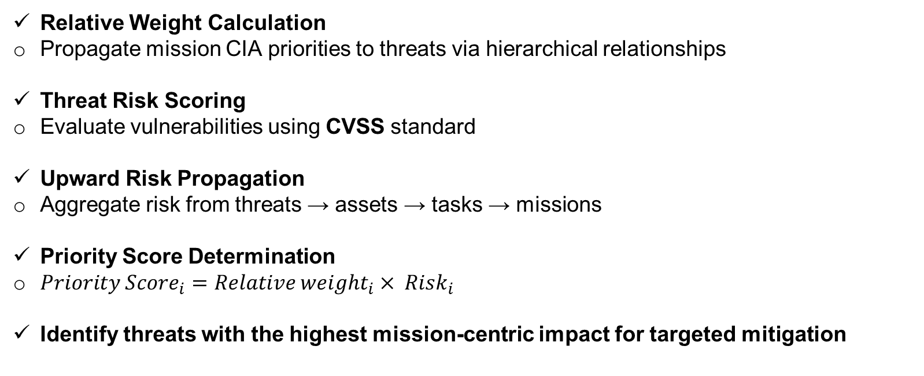
Workflow: Risk Assessment
Relative Weight Calculation
Propagate mission CIA priorities to threats via hierarchical relationships
Threat Risk Scoring
Evaluate vulnerabilities using CVSS standard
Upward Risk Propagation
Aggregate risk from threats → assets → tasks → missions
Priority Score Determination ​
${Priority Score}_{i}={Relative weight}_{i}× {Risk}_{i}$
Identify threats with the highest mission‑centric impact for targeted mitigation

Slide 10
Workflow: Countermeasure Selection
CMU Formula
CMU_{j} = w₁ · RR_{tt} (j) − w₂ · C (j) − w₃ · Q(j) + w₄ · RR_{nt} (j)
Components:
RR_{tt} : Target Threat Risk Reduction
C : Implementation Cost
Q: Service Quality Impact
RR_{nt} : Non-Target Risk Reduction
Weights:
w_{1,2,3,4}: Organization preferences Reflect mission priorities
Balance multiple objectives
Selection Outcome Choose countermeasure with highest CMU for deployment in simulation model

Slide 11
Workflow: Simulation & Evaluation
Virtual Deployment
Implement selected countermeasures within AnyLogic ABM/DES simulation model
Residual Risk Calculation
Recalculate threat risks with updated risk level
Propagate residual risks bottom‑up (Threat → Mission)
Mission‑Level Impact Assessment
Measure reduction in risk across Confidentiality, Integrity, Availability dimensions for all mission objectives
Performance Validation
Compare residual risk metrics to baseline
Confirm alignment with organizational priorities and efficiency in resource utilization

Slide 12



Case Study: Critical Infrastructure
Study Environment
Target: Real-world critical infrastructure network
Tools & Data:
AnyLogic (ABM/DES simulation) Vulnerability scans
MITRE ATT&CK MITRE D3FEND
Mission Objectives:
Service Deployment Service Enhancement Security Assurance
1
2
3

Slide 13





















Case Study Network Topology
Web Site 1
Web Site 2
Link 1
External Network
Link 2
DNS Server
Machine 1
Machine 2
Link 3
Virtual LAN
Local Network
Switch
Router
Figure: Organizational Network - Critical Infrastructure Case Study

Slide 14
Threat Prioritization by Mission Impact
Table: Threat Prioritization Results
ID | Threat Name | Priority
Th3 | Unauthorized Access | 74.17
Th7 | Birthday Attack | 49.47
Th2 | Remote Code Execution | 39.28
Th1 | Server-Side Request Forgery (SSRF) | 22.88
Th5 | Spoofing Attacks | 11.27
Th6 | Plaintext-recovery attacks | 7.13
Th4 | Downgrade of DH parameter curves to export strength | 5.45
Key Insight
Prioritization reflects both technical severity and mission CIA weights

Slide 15
Countermeasure Utility Evaluation
Table: Countermeasure Utility Ranking
ID | Countermeasure Name | Score
CM6 | Apply the latest fixes of OpenSSL | 25.08
CM8 | Implement strong access controls | 22.93
CM10 | Educate users | 21.71
CM7 | Upgrade to supported versions of OpenSSL | 19.86
CM9 | Monitor network traffic | 18.80
CM5 | Implement Network Segmentation | 17.12

Slide 16
Detailed Evaluation for Threat 3
Table: Empirical Evaluation for Threat 3
CM
Cost
Risk Reduction (%)
Avg. Risk
Benefits
/Cost
 | (USD) | C | I | A | Reduction.
CM6 | 100 | 87 | 87 | 87 | 87.0 | 0.870
CM10 | 500 | 87 | 87 | 87 | 87.0 | 0.174
CM7 | 500 | 86 | 85 | 85 | 85.3 | 0.171
CM9 | 1000 | 88 | 89 | 89 | 88.7 | 0.089
CM8 | 1000 | 88 | 87 | 87 | 87.3 | 0.087
CM5 | 3000 | 89 | 90 | 90 | 89.7 | 0.030
Finding: CM6 shows superior cost-effectiveness

Slide 17
After Simulation Mission-Level Risk Reduction
Table: Risk Reduction with respect to Mission Objective
Mission Objective | Availability (%) | Integrity (%) | Confidentiality (%)
Service Deployment | 97 | 97 | 97
Service Enhancement | 85 | 85 | 82
Security Assurance | 89 | 89 | 87
Achievement
Optimal controls achieve significant, quantifiable risk reduction across all critical mission objectives

Slide 18
Conclusion & Key Contributions
The mission‑centric, simulation‑driven framework effectively aligns cybersecurity measures with organizational priorities, delivering measurable risk reduction in critical infrastructure environments.
Research Contributions
Mission-Centric Framework: Bridges technical risk and business objectives
Simulation-Driven: ABM/DES for quantitative evaluation
Standardized Mapping: Uses MITRE ATT&CK/D3FEND
Empirical Validation: Up to 97% risk reduction in critical infrastructure

Slide 19
Future Work & Research Directions
Research Directions:
Integration of automated asset discovery Dynamic threat intelligence feeds
AI-guided mission weight elicitation Extensive cross-sector validation
Real-time adaptive countermeasure selection

Slide 20
Acknowledgment & Data Availability
Acknowledgment: Organizational collaborators Cybersecurity analysts
IT staff
AnyLogic community
Data Availability:
All simulation models available Code and datasets provided Supports reproducibility
Open Access Repository
https://github.com/sajious/ABM-DES_RiskMap

Slide 21
Thank You!
Questions & Discussion
Sajed.yousefi@aut.ac.ir

Slide 22




References
1
J. Watters et al. The Risk-to-Mission Assessment Process (RiskMAP). Technical report, 2009.
V. Viduto et al. A novel risk assessment and optimisation model for network security.
Decision Support Systems, 2012.
F. Li et al. Dynamic countermeasures selection for multi-path attacks. Computers & Security, 2020.
A. Shameli-Sendi et al. Dynamic Optimal Countermeasure Selection for Intrusion Response System. IEEE Trans. on Dependable and Secure Computing, 2018.
2
3
4

