Slide 1



Cryptanalysis of Reduced-Round GFRX-64
Javad Alizadeh, Bahman Madadi
Imam Hossein University, Tehran, Iran
The ISC Int'l Journal of Information Security

Slide 2





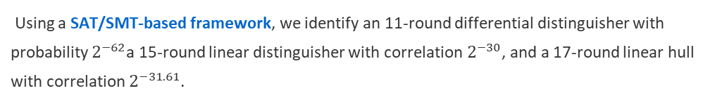

Abstract
This paper presents the first third-party cryptanalysis of the GFRX-64 lightweight block cipher, examining its security against differential and linear attacks.
We introduce neural distinguishers for up to 7 rounds of GFRX-64/96 and extend a 6-round distinguisher to perform an 8-round key recovery attack.
Neural Distinguishers: 1-7 rounds with accuracy up to 100%
Key Recovery: 8-round attack using 6-round neural distinguisher
Using a SAT/SMT-based framework, we identify an 11-round differential distinguisher with probability $2^{−62}$a 15-round linear distinguisher with correlation $2^{−30}$, and a 17-round linear hull with correlation $2^{−31.61}$.
Differential: 11-round characteristic with $2^{−62}$ probability
Our results demonstrate that reducing the cryptanalysis of GFRX to that of SIMON cannot yield accurate security bounds.
Linear: 15-round characteristic with $2^{−30}$ correlation
Linear Hull: 17-round with $2^{−31.61}$ correlation

Slide 3
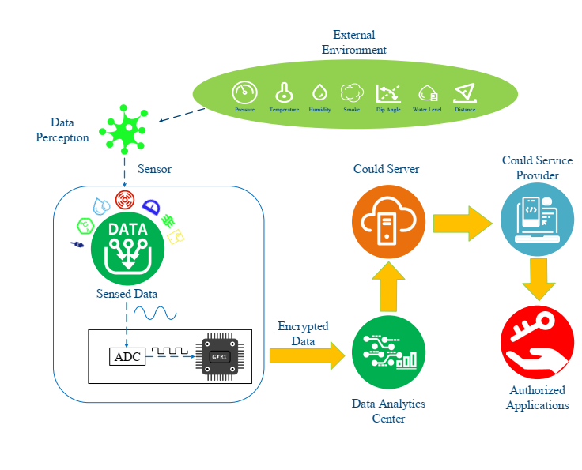








Introduction
Lightweight Block Ciphers
Designed for resource-constrained environments
Two categories: with/without S-boxes
ARX/AND-RX designs use basic operations
Importance for IoT & Embedded Systems
Limited memory and processing power
Critical for securing IoT sensors and embedded devices
GFRX Family
Introduced in 2023 by Zhang et al.
Security Analysis
Structure
Must resist differential and linear attacks
Generalized Feistel with 4 branches
Automated cryptanalysis methods: MILP, CP, SAT/SMT
Operations
ARX/AND-RX: Addition, AND, Rotation, XOR
Variants
GFRX-64/96 (26 rounds), GFRX-64/128 (27 rounds)

Slide 4

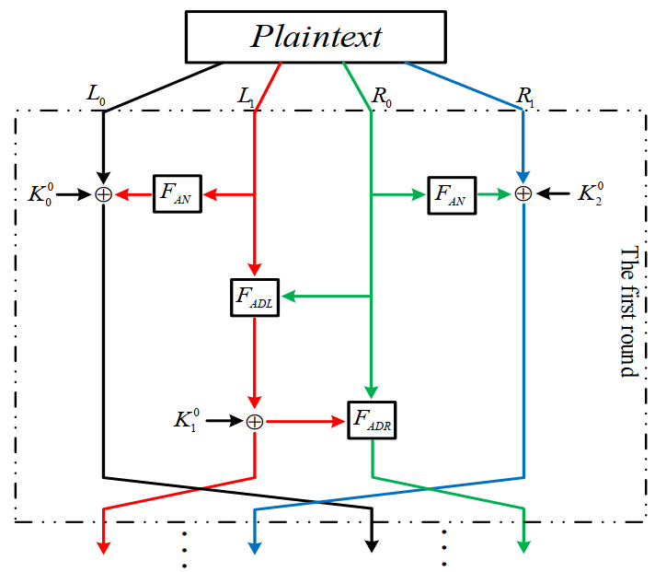








GFRX-64 Specification
Structure
Key Parameters
Block length: 64-128 bits
Key length: 96-256 bits
Number of rounds: 26 (96-bit) or 27 (128-bit)
Rotation parameters: a=1, b=8, c=2, d=8, e=3
Operations: AND, XOR, Rotation, Addition
Structure type: Generalized Feistel
Cipher type: AND-RX
FAN
FADL
FADR
FAN(t) = (t <<< a) & (t <<< b) ⊕ (t <<< c)
FADL(s, t) = (s >>> d) ⊞ t
FADR(s, t) = (s <<< e) ⊕ t

Slide 5





Research Motivation
Designers' Security Claims
GFRX vs. SIMON Comparison
GFRX-64/128 with >19 rounds is resistant to differential cryptanalysis
GFRX-64/128
VS
SIMON-32/64
GFRX-64/128 with >13 rounds is resistant to linear cryptanalysis
4-branch Feistel
2-branch Feistel
Based on similarity to SIMON-32/64 security analysis
AND-RX operations
AND-RX operations
27 rounds
32 rounds
Need for Independent Analysis
128-bit key
64-bit key
No third-party cryptanalysis of GFRX existed
Designed 2023
Designed 2013
Need to verify security claims through independent research
Assess if SIMON-based analysis provides accurate bounds
Designers claimed half of GFRX is similar to SIMON
Does this similarity guarantee security?

Slide 6








Research Contributions
Neural Distinguishers
SAT/SMT-based Analysis
Developed for 1-7 rounds of GFRX-64/96
11-round differential with probability $2^{−62}$
Based on ResNet architecture
15-round linear with correlation $2^{−30}$
Optimal input difference: (0x0, 0x0, 0x0, 0x0040)
17-round linear hull with correlation $2^{−31.61}$
Best Accuracy (7_Round)
62.64%
Improvement
2 + 2 rounds
Key Recovery Attack
Key Finding
First third-party cryptanalysis of GFRX demonstrates that reducing analysis to SIMON cannot yield accurate security bounds
Extended 6-round distinguisher to 8-round attack
Uses partial decryption of final round

Slide 7

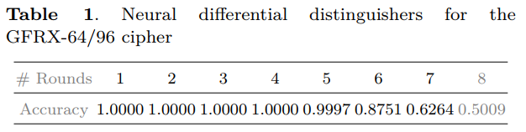

Neural Distinguishers Overview
Deep Learning Approach
Training Parameters
Detects statistical biases in cipher outputs
Dataset size: ${10}^{7}$training samples
Trained to classify cipher vs random data
Optimizer: Adam with cyclic learning rate
Based on ResNet architecture with shortcut connections
Loss function: Mean Squared Error (MSE)
Data Generation Process
Key Finding
Input difference: (0x0, 0x0, 0x0, 0x0040)
Neural distinguishers effective up to 7 rounds with accuracy > 62.6%. Beyond 7 rounds, accuracy approaches random guessing (50%).
Positive samples: Cipher text pairs with specific difference
Negative samples: Randomly generated cipher text pairs
Each sample: 128 bits (4×16-bit words × 2 cipher texts)
Accuracy by Round

Slide 8







Key Recovery Attack
Attack Overview
Attack Process
Extends 6-round neural distinguisher to 8-round attack
Uses partial decryption of final round
Input Preparation
Generate plaintext pairs with specific input difference
Focuses on recovering one 16-bit subkey word at a time
8-Round Encryption
Encrypt pairs through full 8 rounds of GFRX-64/96
Key Recovery Algorithm
1
Generate n plaintext pairs with input difference ∆in
Partial Decryption
2
Encrypt through 8 rounds of GFRX-64/96
Decrypt final round with each candidate subkey
3
For each candidate subkey κ ($2^{16}$ possibilities):
Neural Scoring
4
Partially decrypt one round using κ
Apply 6-round neural distinguisher to intermediate states
5
Feed into 6-round neural distinguisher
6
Compute
Key Ranking
7
Rank all candidate keys by score
Aggregate scores and rank candidate keys

Slide 9



SAT/SMT-based Cryptanalysis Overview
Automated Cryptanalysis
SAT/SMT Tools & Framework
Systematic approach to finding distinguishers
Converts cipher behavior into logical formulas
Crypto SMT
Enables exhaustive search for optimal characteristics
Automated cryptanalysis tool for symmetric ciphers
STP Solver
Modeling Process
Efficient SAT/SMT solver for cryptographic problems
1
Model Cipher Operations
Convert each operation to CNF formula
CNF Representation
Model Attack Behavior
Conjunctive Normal Form for logical formulas
2
Define differential/linear constraints
3
Optimization Objective
Minimize probability/correlation
4
Solve SAT/SMT Problem
Find optimal distinguisher

Slide 10
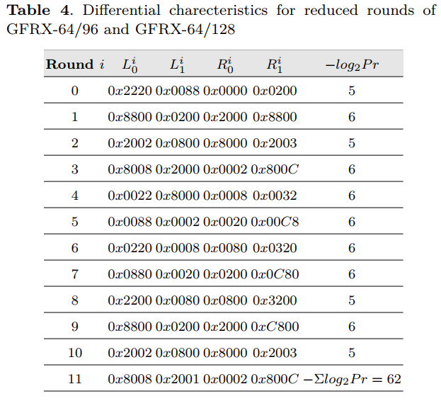







Differential Cryptanalysis Methodology
11-Round Differential Characteristic
Differential Trail
Input: (0x2220, 0x0088, 0x0000, 0x0200)
Output: (0x8008, 0x2001, 0x0002, 0x800C)
Probability: $2^{−62}$
Designers' Claim
GFRX-64/128 with >19 rounds resistant to differential attacks
Our Result
11-round differential characteristic with probability $2^{−62}$
Methodology Difference
Key Finding
Direct analysis vs. SIMON-based bounds
The 11-round differential characteristic matches the designers' claim but provides direct analysis of the full GFRX-64 cipher rather than relying on SIMON-32/64 bounds.

Slide 11
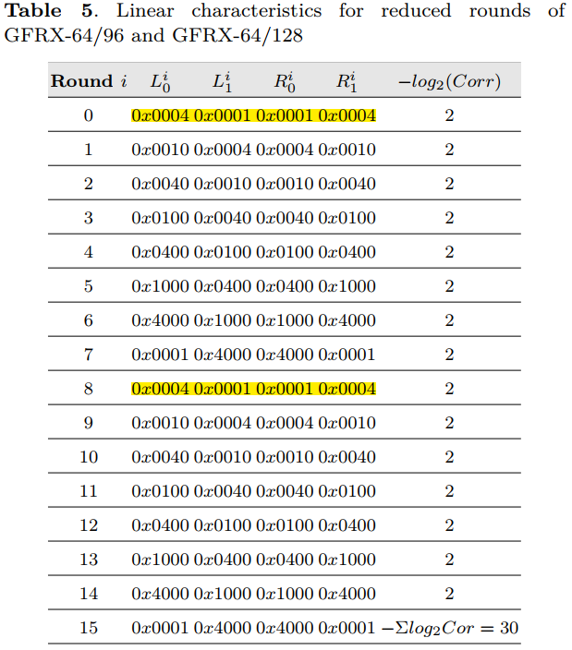


Linear Cryptanalysis Methodology
Linear Behavior Modeling
Examines linear relationships between plaintext, ciphertext, and key bits
Models input/output masks for each operation
Converts to CNF formulas for SAT/SMT solving
Search Process
1
Model GFRX-64 operations as SAT/SMT constraints
2
Define objective function to minimize correlation
3
Use CryptoSMT tool with STP solver
4
Find optimal linear characteristic for each round count
Designers' Claim
GFRX-64/128 with >13 rounds resistant to linear attacks
Our Result
15-round linear characteristic with correlation 2-30
Improvement
+2 rounds beyond designers' claim

Slide 12


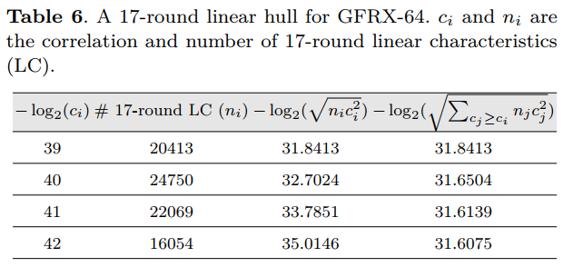


Linear Hull Analysis
17-Round Linear Hull
Linear Hull Significance
Linear Hull Details
Aggregation Effect
Input Mask: (0x0080, 0x0060, 0x0020, 0x0080)
Combining multiple linear characteristics increases overall correlation
Output Mask: (0x0004, 0x0080, 0x0080, 0x0004)
Correlation:$2^{−31.6075}$
Extended Range
Linear hull extends attack by 2 more rounds than single characteristic
Security Impact
Demonstrates vulnerability beyond designers' 13-round claim
Key Findings
83,286 characteristics aggregated
4 correlation levels identified
+4 rounds beyond designers' claim

Slide 13





Conclusion
Key Findings
Future Research Directions
Neural Distinguishers
Extended Analysis
7-round distinguishers with high accuracy
Apply similar techniques to other block cipher
8-round key recovery attack
Advanced Neural Methods
Explore transformer-based architectures for cipher analysis
SAT/SMT Analysis
11-round differential with $2^{−62}$ probability
Practical Attacks
15-round linear with $2^{−30}$ correlation
Develop full key recovery attacks beyond 8 rounds
17-round linear hull with $2^{−31.6075}$ correlation
Cipher Design
Propose improvements to GFRX based on identified weaknesses
First third-party analysis of GFRX-64
Invalidates reliance on SIMON bounds
Multiple approaches confirm vulnerabilities

Slide 14







Questions & Thank You
Contact Information
Javad Alizadeh
JAlizadeh@ihu.ac.ir
Bahman Madadi
BahmanMadadi@ihu.ac.ir
Imam Hossein University, Tehran, Iran
Source Code
Available at: https://github.com/CryptanalysisGFRX/GFRX64.git
Key References
Zhang et al. "Gfrx: A new lightweight block cipher for resource-constrained iot nodes." Electronics, 12(2):405, 2023.
Questions?
Gohr, A. "Improving attacks on round-reduced speck32/64 using deep learning." CRYPTO 2019.
Thank you for your attention
Sun, L., Wang, W., and Wang, M. "Accelerating the search of differential and linear characteristics with the sat method." IACR Transactions, 2021.

