Slide 1

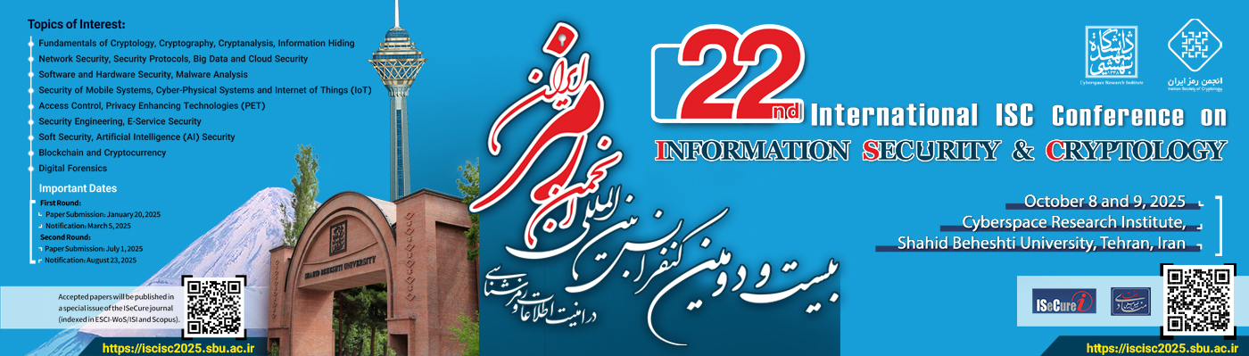
An LSTM-DBSCAN Approach for Interpretable Insider Threat Detection via Behavioral Anomaly Analysis
Mohammad Mohammadi, Moein Bannaye Zahmati, and Morteza Noferesti
Department of Computer Engineering, Bozorgmehr University of Qaenat

Slide 2

Insider Threat detection
Insider threats: Authorized users (employees, contractors, partners) exploiting access to harm organizations
Unlike external attacks, they bypass traditional security (firewalls, IDS)
Categories: Feature engineering, sequence-based (RNN/LSTM), graph-based (GNN)

Slide 3

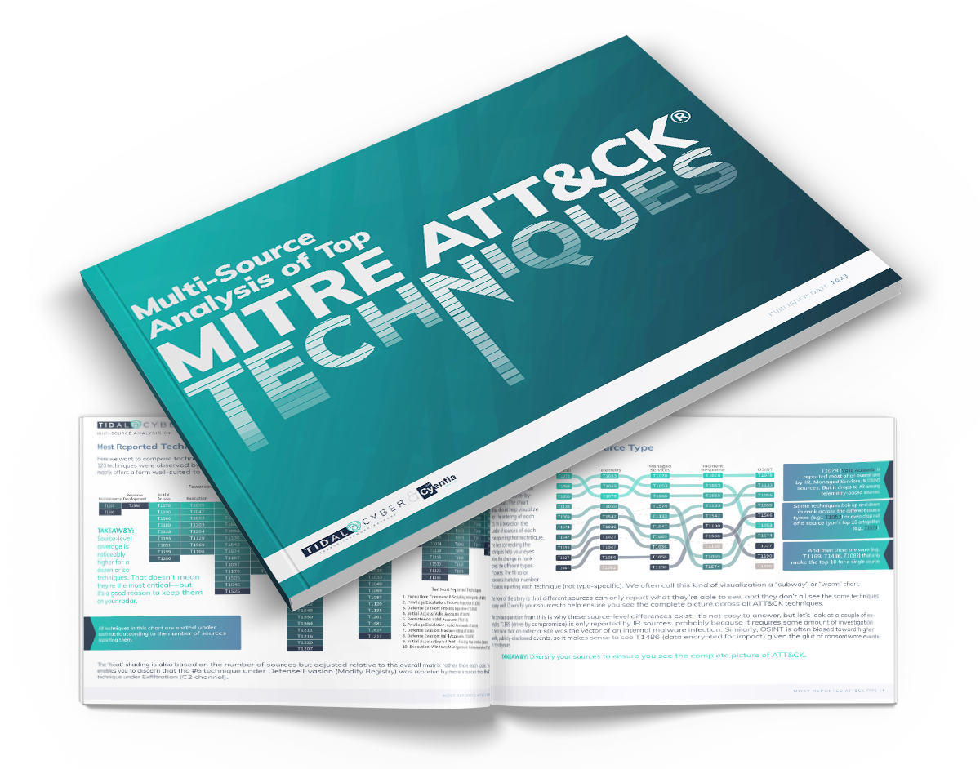
Critical Challenges in AI-Driven ITD
Lack of Interpretability: Black-box models provide scores without explanations.
Misleading Evaluation: Class imbalance leads to inflated metrics.
Taxonomy Divide: No alignment with operational frameworks like MITRE ATT&CK.

Slide 4
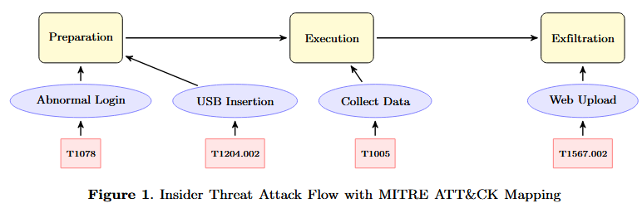
MITRE ATT&CK Mapping for Scenario
Focus Scenario: Non-working hours login + USB + external URL upload.

Slide 5
Related Work
Interpretability Limitations: GNNs (LAN), CNN-Transformers (CATE), DRL (ProAPT)—lack action mapping
Misleading Metrics: EBIGAN (imbalanced data handling), LAN (artificial balancing)
Taxonomy Misalignment: Stacked LSTMs, Semi-supervised (SVM/RF/MLP)—no MITRE integration

Slide 6
Proposed Approach: Overview
Stage 1: LSTM Autoencoder for temporal anomalies
Stage 2: DBSCAN for file/device
Stage 3: DBSCAN for URL exfiltration

Slide 7
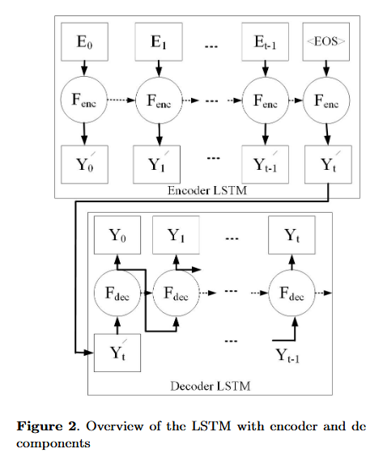
Stage 1: Login Event Preprocessing and LSTM Anomaly Detection
Preprocessing: Extract features (Duration -8h, Time to Start/Finish Work) in seconds
LSTM Autoencoder: 2 layers (64/32 units), MSE loss, early stopping
Detection: Flag sessions with MSE > threshold (95th percentile)
Maps to T1078 Mitre technique

Slide 8
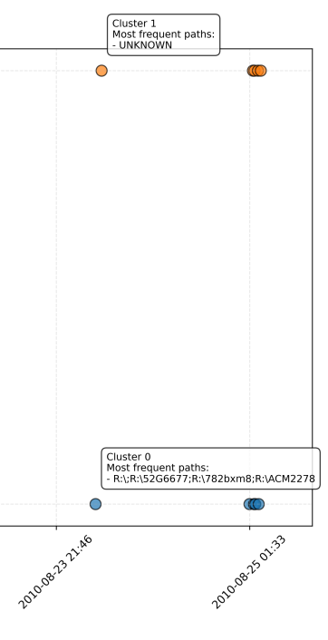
Stage 2: Device Activity Analysis with DBSCAN
Filter events within anomalous sessions (same PC, time window)
Preprocess: TF-IDF on file paths
DBSCAN: ε=0.1, min_samples=2, cosine metric—clusters suspicious accesses (removable devices)
Maps to T1005/T1204.002

Slide 9
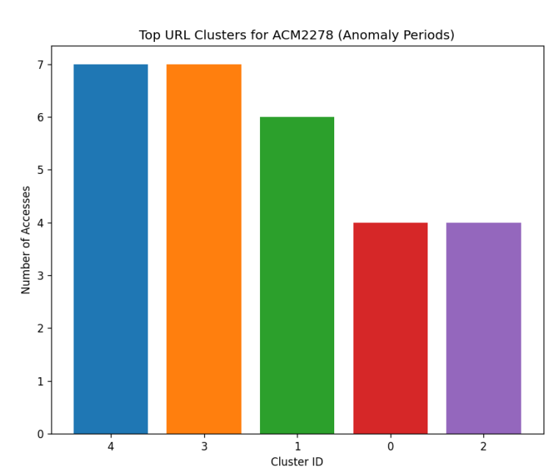
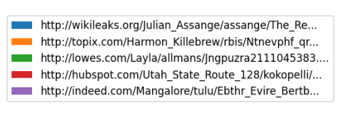
Stage 3: URL Activity Analysis with DBSCAN
Filter web events in chunks within sessions
Preprocess: Extract domain/path, TF-IDF (max 500 features, stop words removed)
DBSCAN: ε=0.3, min_samples=3—clusters semantic patterns and transfer volume
Maps to T1567.002

Slide 10

Evaluation Setup
Environment: Ubuntu 20.04, Intel i5, Python 3.11 (pandas, scikit-learn, TensorFlow)
Dataset: CERT r6.2
137M events
4,000 users
18 months
Carnegie Mellon University’s CERT Division

Slide 11
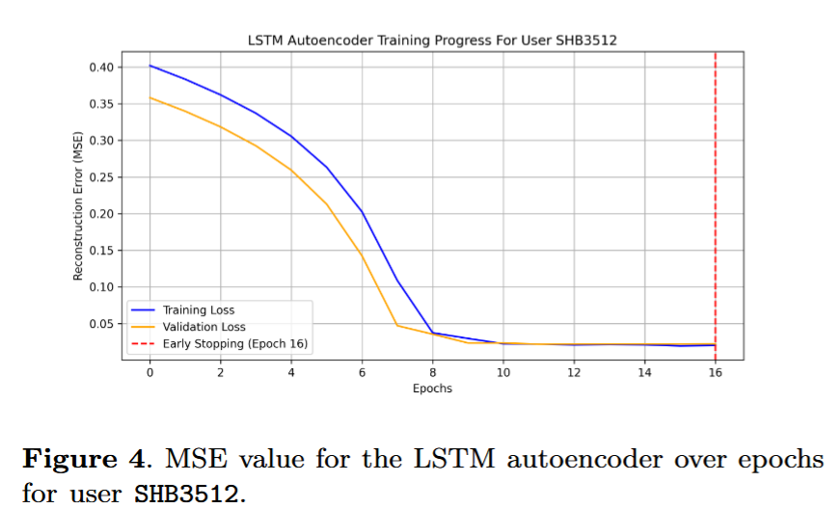
Experimental Results: Performance
LSTM: 73,491 anomalies detected
DBSCAN: 26,558 URL clusters, 12 device clusters

Slide 12
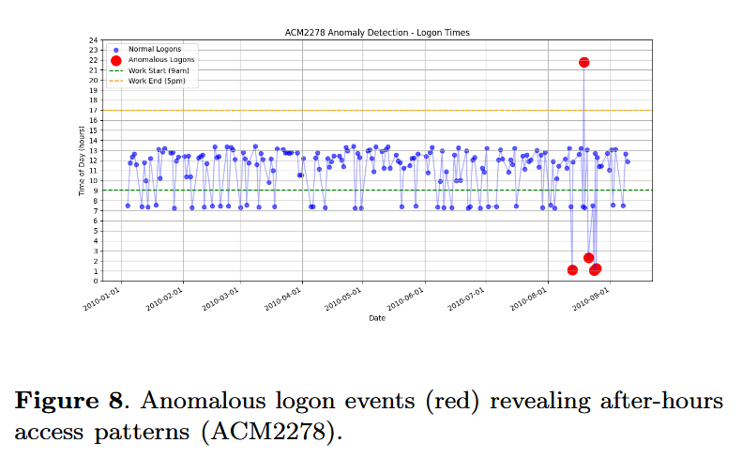
Detected Attack Scenario
User ACM2278: After-hours logins (Aug 21-24, 2010), USB removals, Wikileaks visits
Chain: Temporal anomalies → Device clusters → URL exfiltration

Slide 13
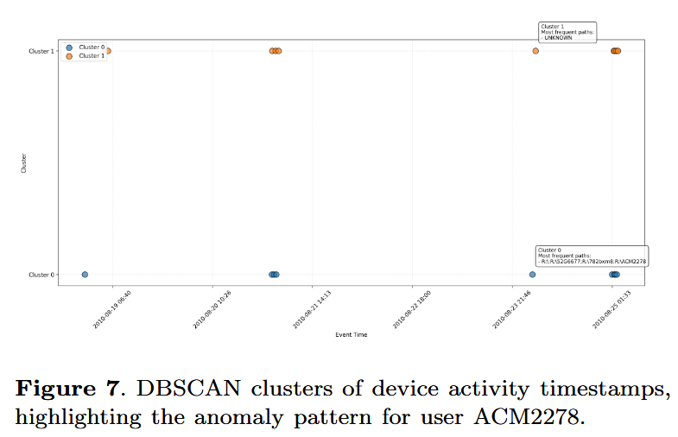
Detected Attack Scenario (2)

Slide 14
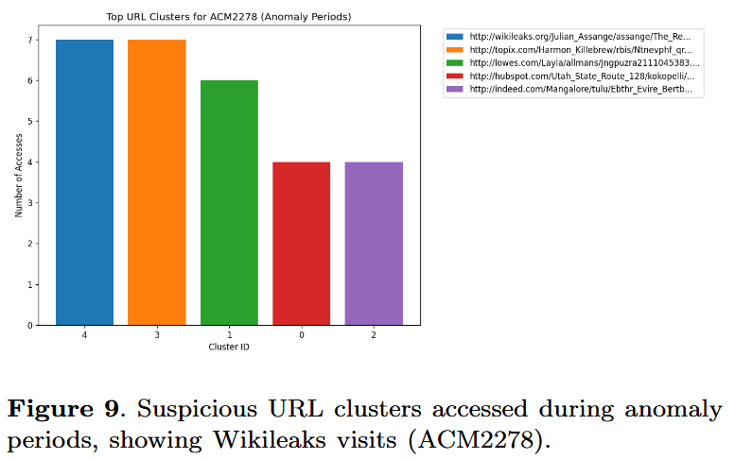
Detected Attack Scenario (3)

Slide 15
Conclusion
Proposed approach: Integrated LSTM-DBSCAN detects interpretable threat chains
Outperforms baselines in interpretability and real-world applicability
Validates MITRE coverage (T1078, T1005, T1204.002, T1567.002)
Handles imbalance without synthetic data
Key Benefits: Actionable alerts, SOC integration, reduced false positives

Slide 16

Future Work
Validate on real enterprise data (noisy environments)
Real-time streaming (Apache Flink/Kafka)
Advanced triage with root-cause explainability
Broader threats (sabotage, credential theft)

Slide 17
Q&A
Thank you for your attention
I'm ready to answer your questions
Mohammad Mohammadi, Moein Bannaye Zahmati, and Morteza Noferesti
mohammadi.ai.eng@gmail.com, moein.bannaye.zahmati@gmail.com, mnoferesti@buqaen.ac.ir
Department of Computer Engineering, Bozorgmehr University of Qaenat

